Slide 1
Decision Tree
Marlabs

Slide 2
Tree based learning algorithms
Tree based learning algorithms are considered to be one of the best and mostly used supervised learning methods.
Tree based methods empower predictive models with high accuracy, stability and ease of interpretation.
Unlike linear models, they map non-linear relationships quite well. They are adaptable at solving any kind of problem at hand (classification or regression).

Slide 3
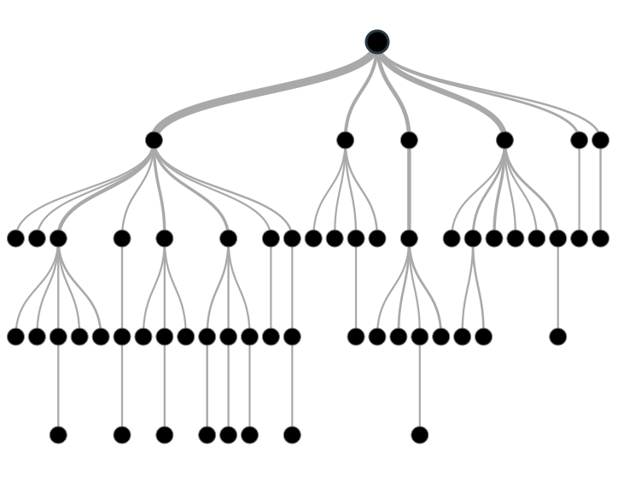
What is a Decision Tree ? How does it work ?
Decision tree is a type of supervised learning algorithm (having a pre-defined target variable) that is mostly used in classification problems.
It works for both categorical and continuous input and output variables.
In this technique, we split the population or sample into two or more homogeneous sets (or sub-populations) based on most significant splitter / differentiator in input variables.

Slide 4
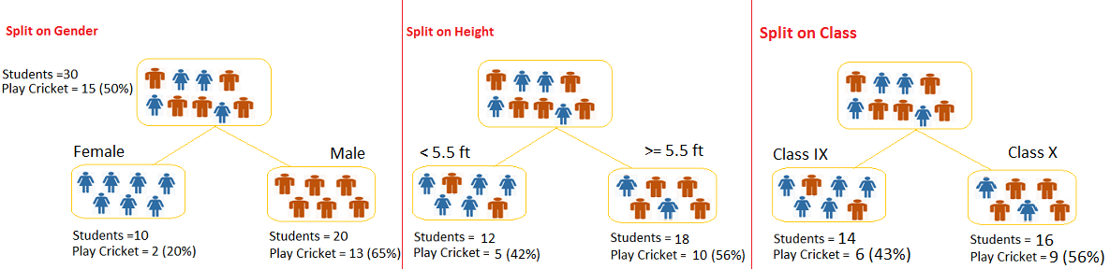
Example
The goal: predict who will play cricket during leisure period?
How the decision tree solve this problem?
Segregate the students based on all values of three variable
Identify the variable, which creates the best homogeneous sets of students (which are heterogeneous to each other).
Decision tree identifies the most significant variable and it’s value that gives best homogeneous sets of population.

Slide 5
Two Types of Decision Tree
Categorical Variable Decision Tree: Decision Tree which has categorical target variable.
Continuous Variable Decision Tree: Decision Tree has continuous target variable.

Slide 6
Important Terminology
Root Node: It represents entire population or sample and this further gets divided into two or more homogeneous sets.
Splitting: It is a process of dividing a node into two or more sub-nodes.
Decision Node: When a sub-node splits into further sub-nodes, then it is called decision node.
Leaf/ Terminal Node: Nodes do not split is called Leaf or Terminal node.
Pruning: When we remove sub-nodes of a decision node, this process is called pruning. You can say opposite process of splitting.
Branch / Sub-Tree: A sub section of entire tree is called branch or sub-tree.
Parent and Child Node: A node, which is divided into sub-nodes is called parent node of sub-nodes where as sub-nodes are the child of parent node.

Slide 7
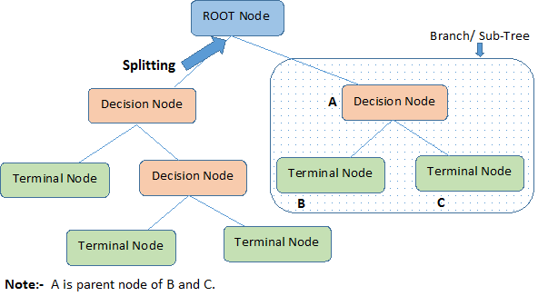
Important Terminologies

Slide 8
Advantages & Disadvantages of Decision Tree
Advantages
Easy to Understand.
Useful in Data exploration: Decision tree is one of the fastest way to identify most significant variables and relation between two or more variables.
Less data cleaning required: It requires less data cleaning compared to some other modeling techniques. It is not influenced by outliers and missing values to a fair degree.
Data type is not a constraint: It can handle both numerical and categorical variables.
Non Parametric Method: Decision tree is considered to be a non-parametric method. This means that decision trees have no assumptions about the space distribution and the classifier structure.
Disadvantages
Over fitting: Over fitting is one of the most practical difficulty for decision tree models. This problem gets solved by setting constraints on model parameters and pruning (discussed in detailed below).
Not fit for continuous variables: While working with continuous numerical variables, decision tree looses information when it categorizes variables in different categories.

Slide 9
Regression Tree VS. Classification Tree
Regression trees are used when dependent variable is continuous. Classification trees are used when dependent variable is categorical.
In case of regression tree, an unseen data observation falls in that region, we’ll make its prediction with mean value.
In case of classification tree, an unseen data observation falls in that region, we’ll make its prediction with mode value.
Both the trees divide the independent variables into distinct and non-overlapping regions.
Both the trees follow a top-down greedy approach known as recursive binary splitting It is known as ‘greedy’ because, the algorithm cares about only the current split, and not about future splits which will lead to a better tree.
This splitting process is continued until a user defined stopping criteria is reached.

Slide 10
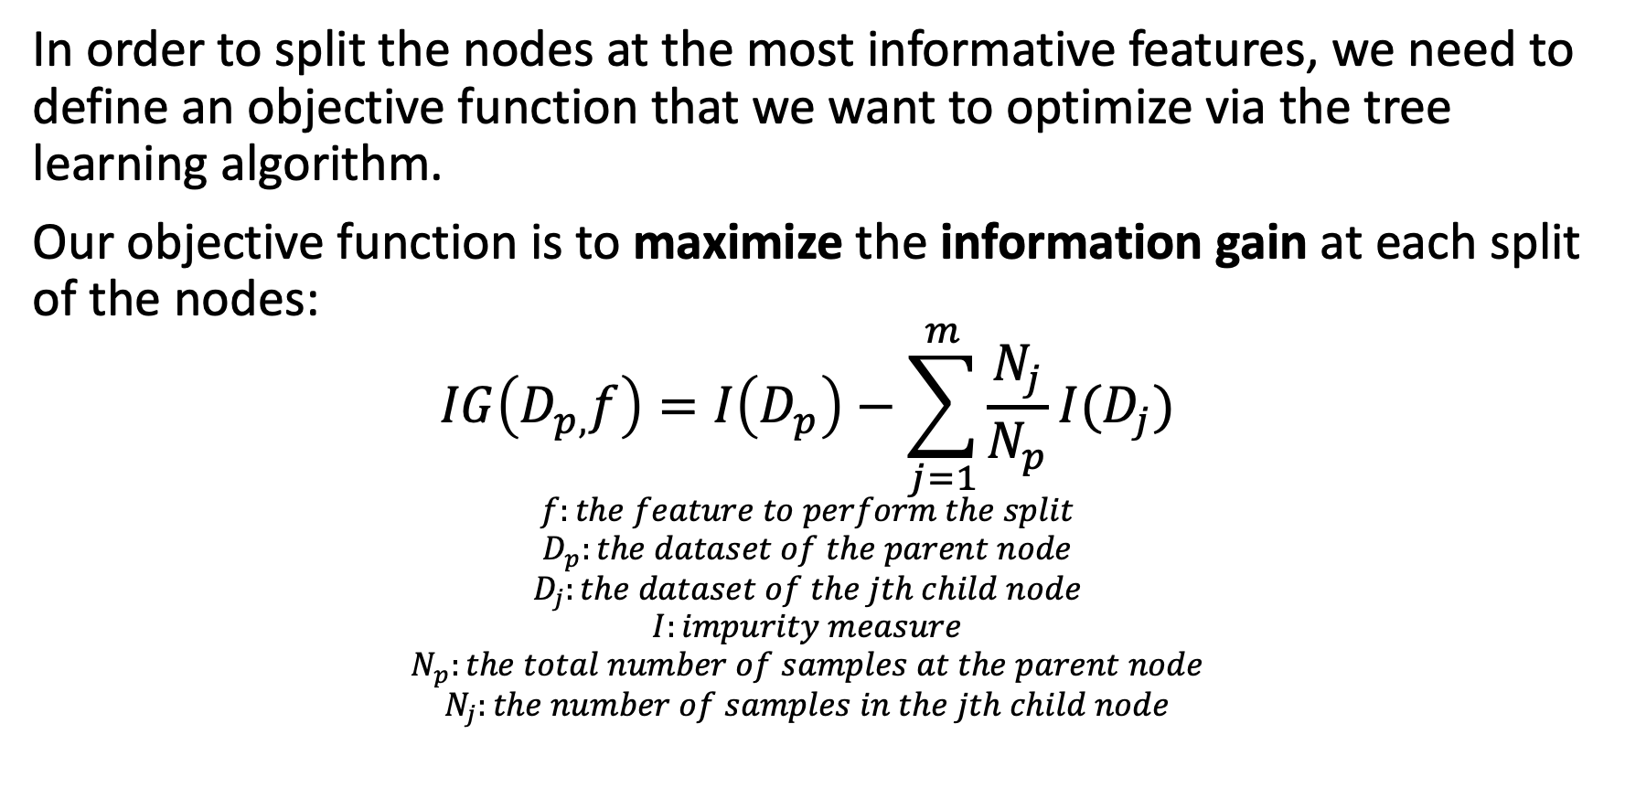
How does a tree decide where to split? Impurity Measures or Splitting Criteria (3 Methods)
In order to split the nodes at the most informative features, we need to define an objective function that we want to optimize via the tree learning algorithm.
Our objective function is to maximize the information gain at each split of the nodes:
$$IG\left(D_{p,}f\right)=I\left(D_{p}\right)−\sum_{j=1}^{m}{\frac{N_{j}}{N_{p}}I(D_{j})}$$
$$f:the feature to perform the split$$
$$D_{p}:the dataset of the parent node$$
$$D_{j}:the dataset of the jth child node$$
$$I:impurity measure$$
$$N_{p}:the total number of samples at the parent node$$
$$N_{j}:the number of samples in the jth child node$$

Slide 11
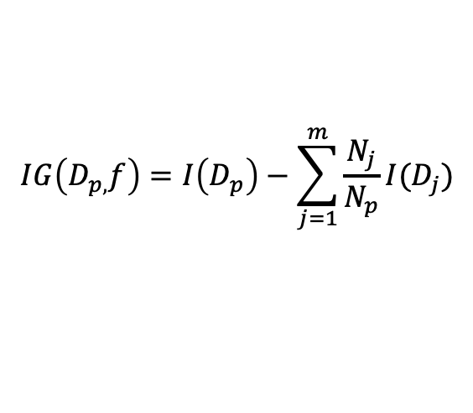
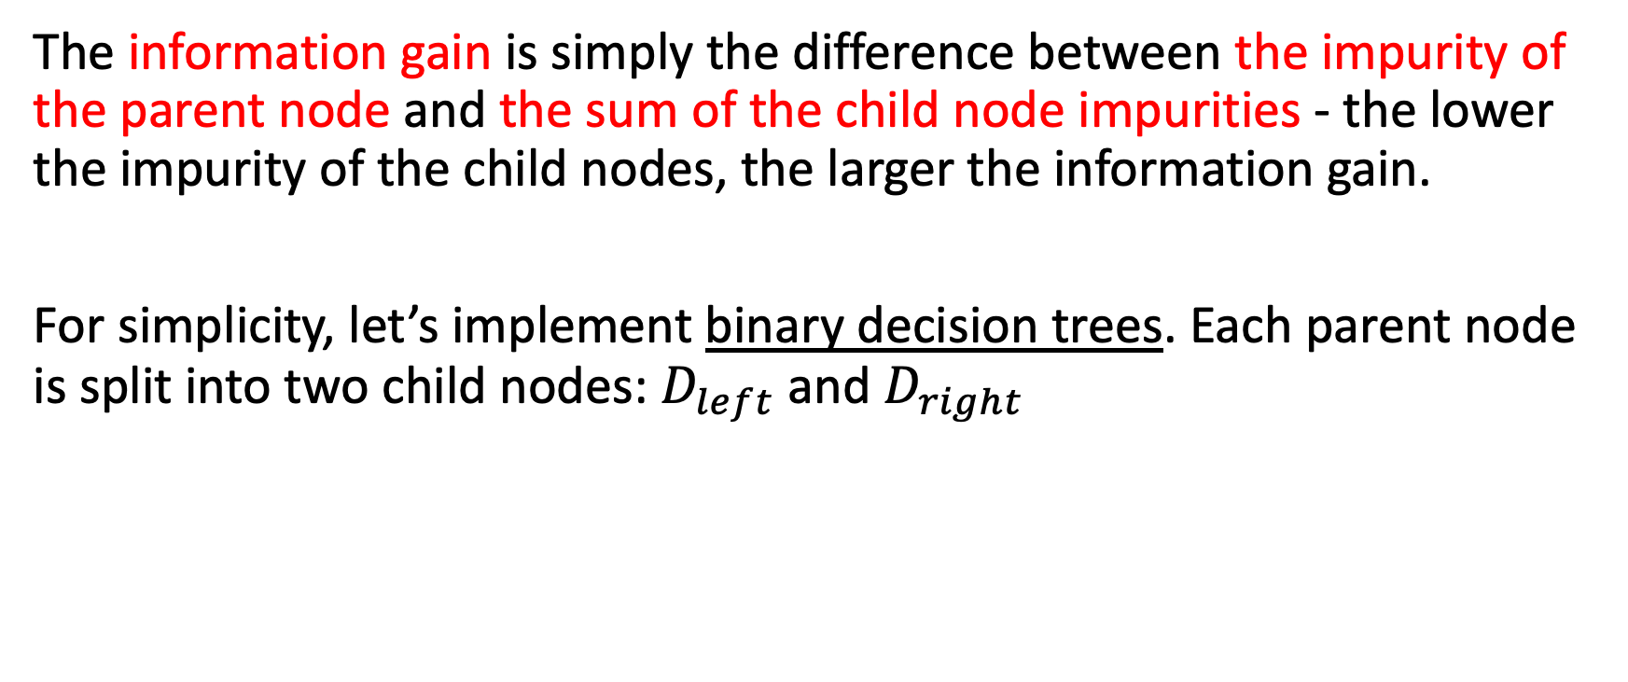
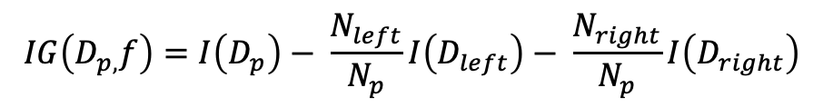
$$IG\left(D_{p,}f\right)=I\left(D_{p}\right)−\sum_{j=1}^{m}{\frac{N_{j}}{N_{p}}I(D_{j})}$$
The information gain is simply the difference between the impurity of the parent node and the sum of the child node impurities - the lower the impurity of the child nodes, the larger the information gain.
For simplicity, let’s implement binary decision trees. Each parent node is split into two child nodes: $D_{left}$ and $D_{right}$
$$IG\left(D_{p,}f\right)=I\left(D_{p}\right)− \frac{N_{left}}{N_{p}}I\left(D_{left}\right)− \frac{N_{right}}{N_{p}}I\left(D_{right}\right)$$

Slide 12
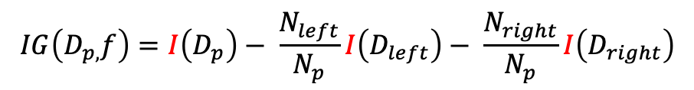
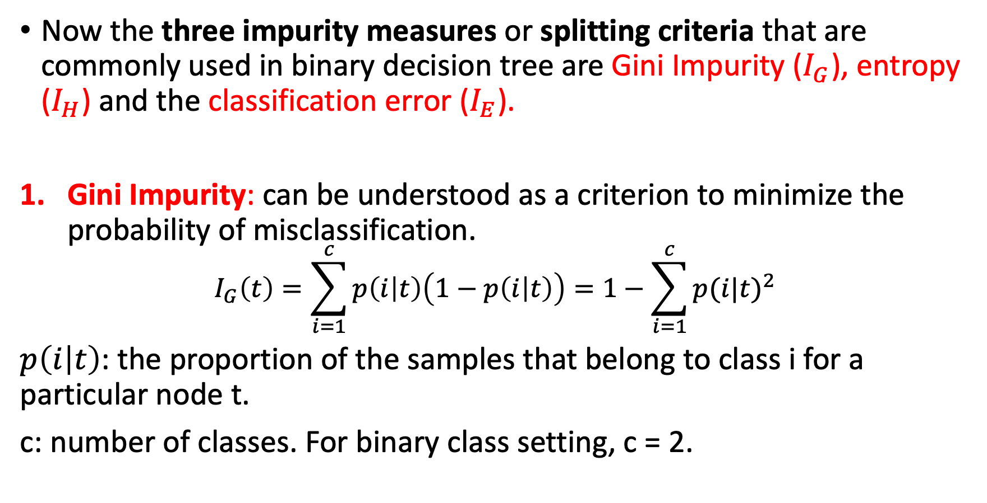
$$IG\left(D_{p,}f\right)=I\left(D_{p}\right)− \frac{N_{left}}{N_{p}}I\left(D_{left}\right)− \frac{N_{right}}{N_{p}}I\left(D_{right}\right)$$
Now the three impurity measures or splitting criteria that are commonly used in binary decision tree are Gini Impurity ($I_{G}$), entropy ($I_{H}$) and the classification error ($I_{E}$).
Gini Impurity: can be understood as a criterion to minimize the probability of misclassification.
$$I_{G}\left(t\right)=\sum_{i=1}^{c}{p\left(i | t\right)\left(1−p\left(i | t\right)\right)=1−\sum_{i=1}^{c}{p{(i|t)}^{2}}}$$
$p\left(i | t\right)$: the proportion of the samples that belong to class i for a particular node t.
c: number of classes. For binary class setting, c = 2.

Slide 13
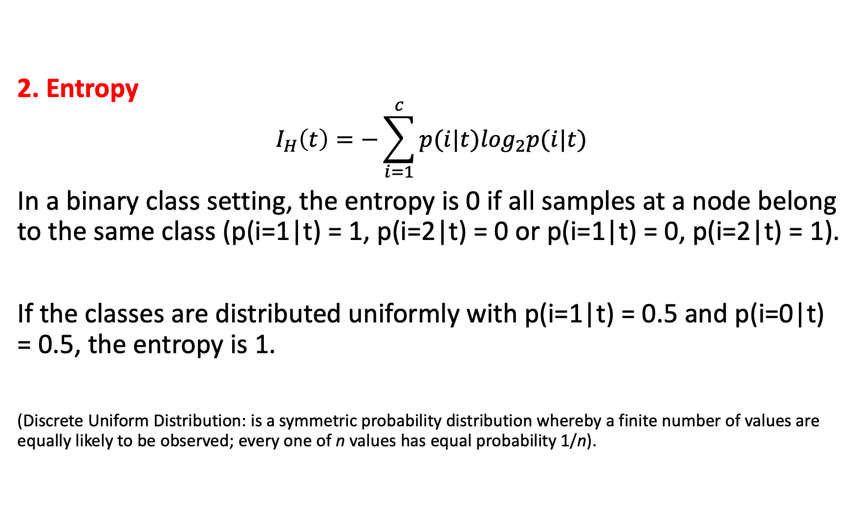
2. Entropy
$$I_{H}\left(t\right)=−\sum_{i=1}^{c}{p(i|t)\log_{2}p(i|t)}$$
In a binary class setting, the entropy is 0 if all samples at a node belong to the same class (p(i=1|t) = 1, p(i=2|t) = 0 or p(i=1|t) = 0, p(i=2|t) = 1).
If the classes are distributed uniformly with p(i=1|t) = 0.5 and p(i=0|t) = 0.5, the entropy is 1.
(Discrete Uniform Distribution: is a symmetric probability distribution whereby a finite number of values are equally likely to be observed; every one of n values has equal probability 1/n).

Slide 14

3. Classification Error
$$I_{E}=1−max⁡\{p(i|t)\}$$

Slide 15
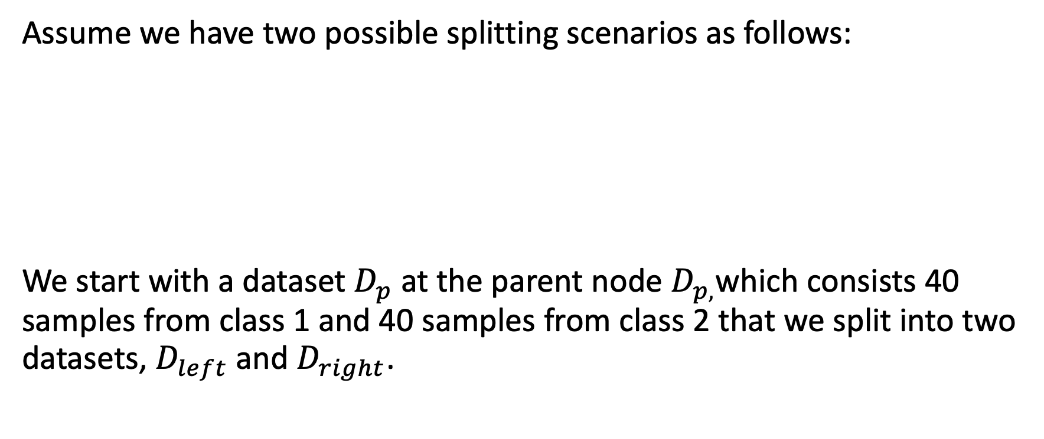
How does a tree decide where to split?
Impurity Measures or Splitting Criteria (Example)
Assume we have two possible splitting scenarios as follows:
We start with a dataset${ D}_{p}$ at the parent node $D_{p,}$which consists 40 samples from class 1 and 40 samples from class 2 that we split into two datasets, $D_{left}$ and $D_{right}$.
(40,40)
(30,10)
(10,30)
A
(40,40)
(20,40)
(20,0)
B

Slide 16
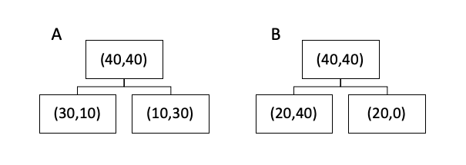
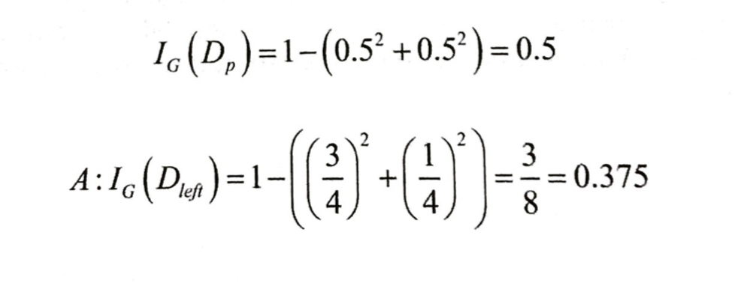
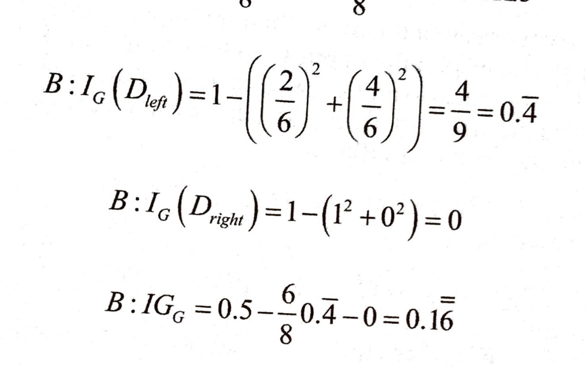
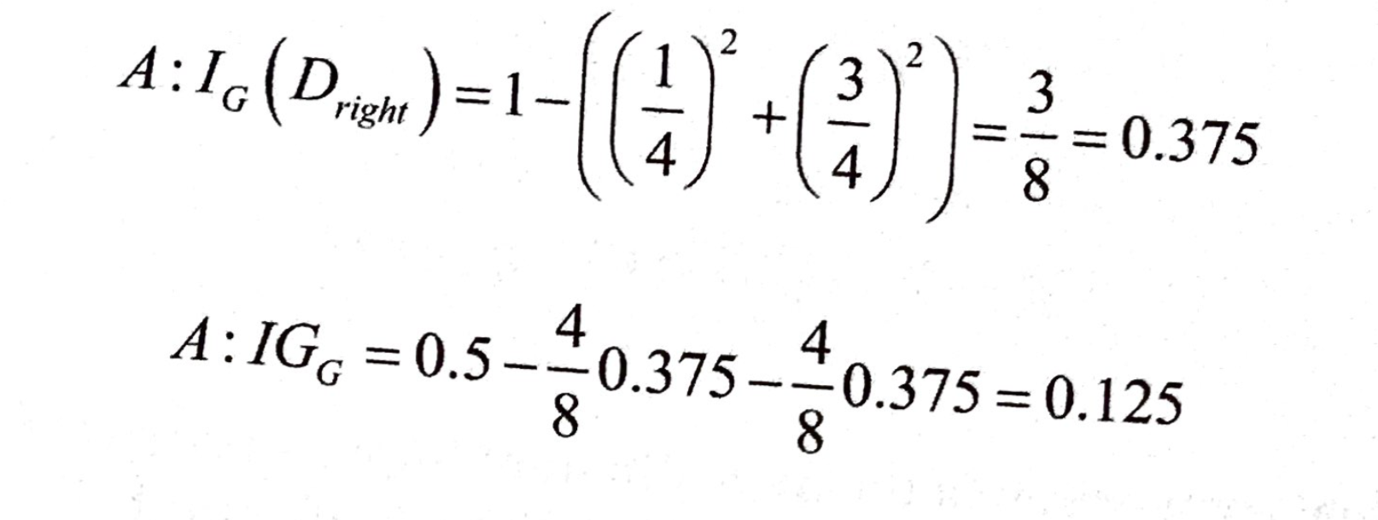
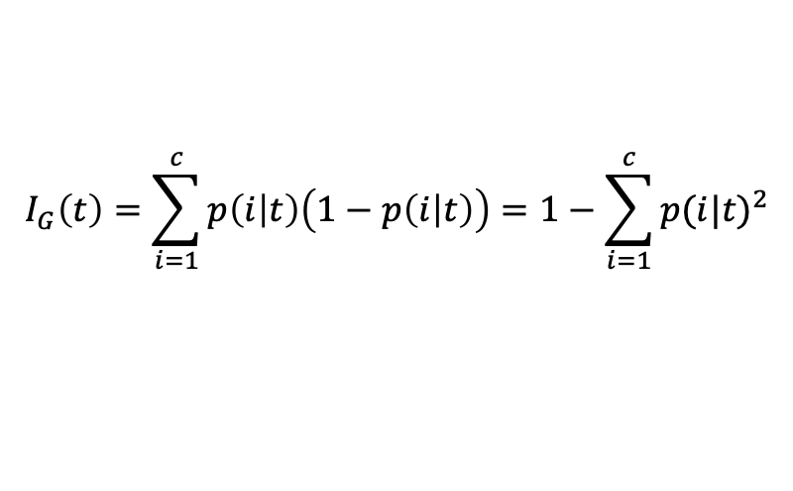
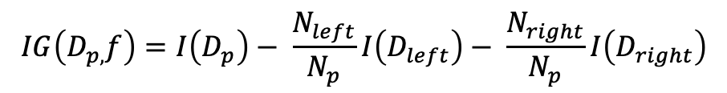
$$I_{G}\left(t\right)=\sum_{i=1}^{c}{p\left(i | t\right)\left(1−p\left(i | t\right)\right)=1−\sum_{i=1}^{c}{p{(i|t)}^{2}}}$$
$$IG\left(D_{p,}f\right)=I\left(D_{p}\right)− \frac{N_{left}}{N_{p}}I\left(D_{left}\right)− \frac{N_{right}}{N_{p}}I\left(D_{right}\right)$$
Gini Impurity
The gini impurity would favor scenario B over scenario A.

Slide 17
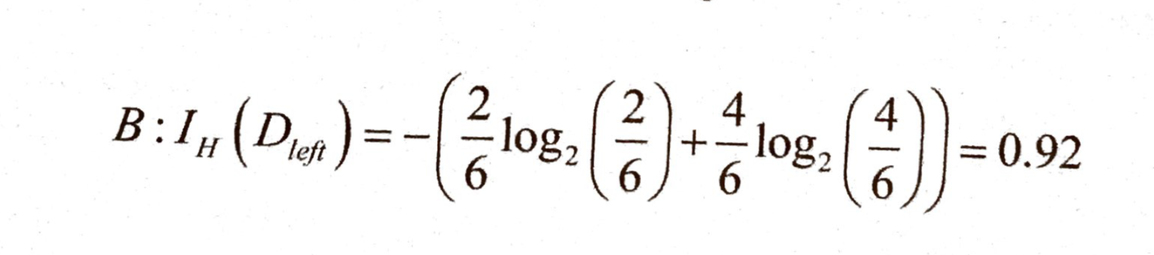
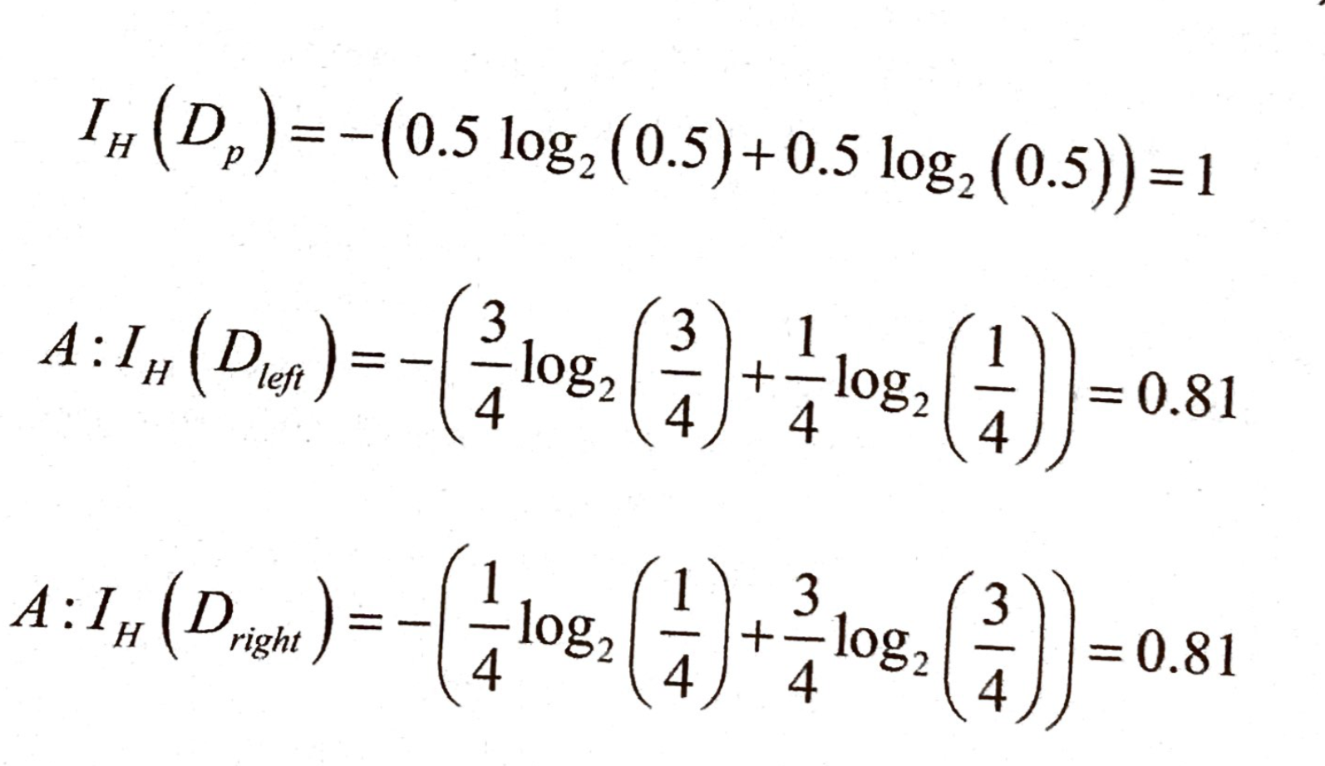
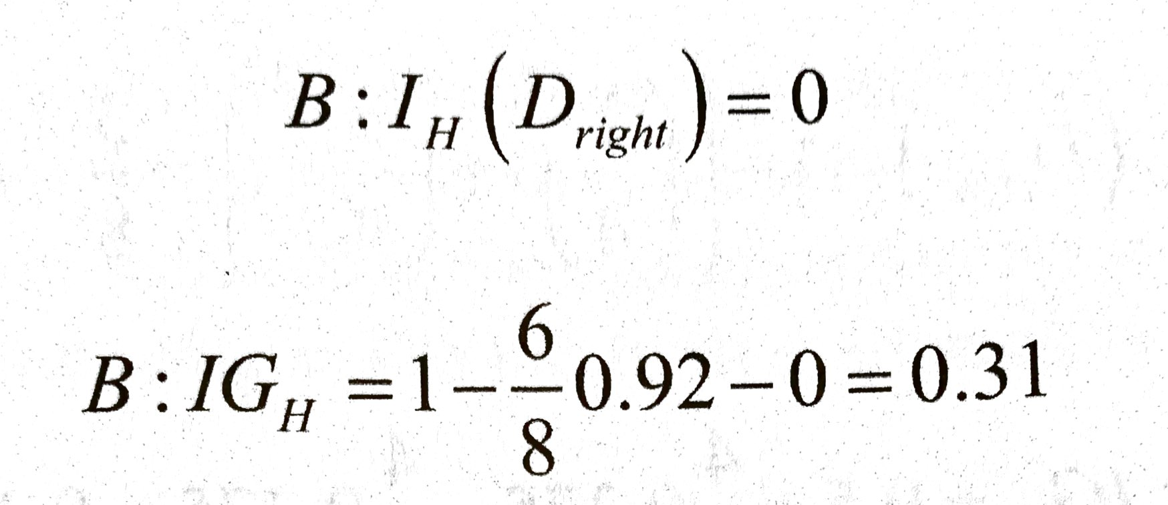
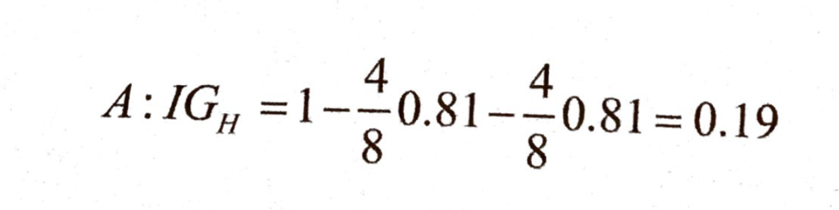
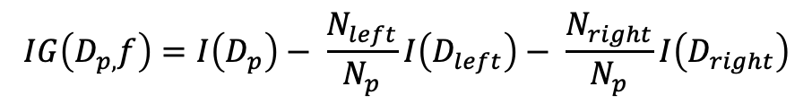
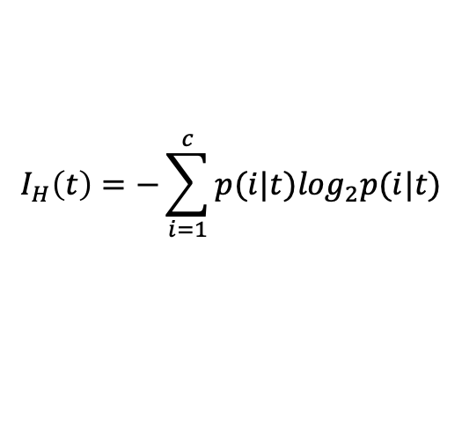
$$I_{H}\left(t\right)=−\sum_{i=1}^{c}{p(i|t)\log_{2}p(i|t)}$$
$$IG\left(D_{p,}f\right)=I\left(D_{p}\right)− \frac{N_{left}}{N_{p}}I\left(D_{left}\right)− \frac{N_{right}}{N_{p}}I\left(D_{right}\right)$$
2. Entropy
The entropy criterion would favor scenario B over scenario A.

Slide 18
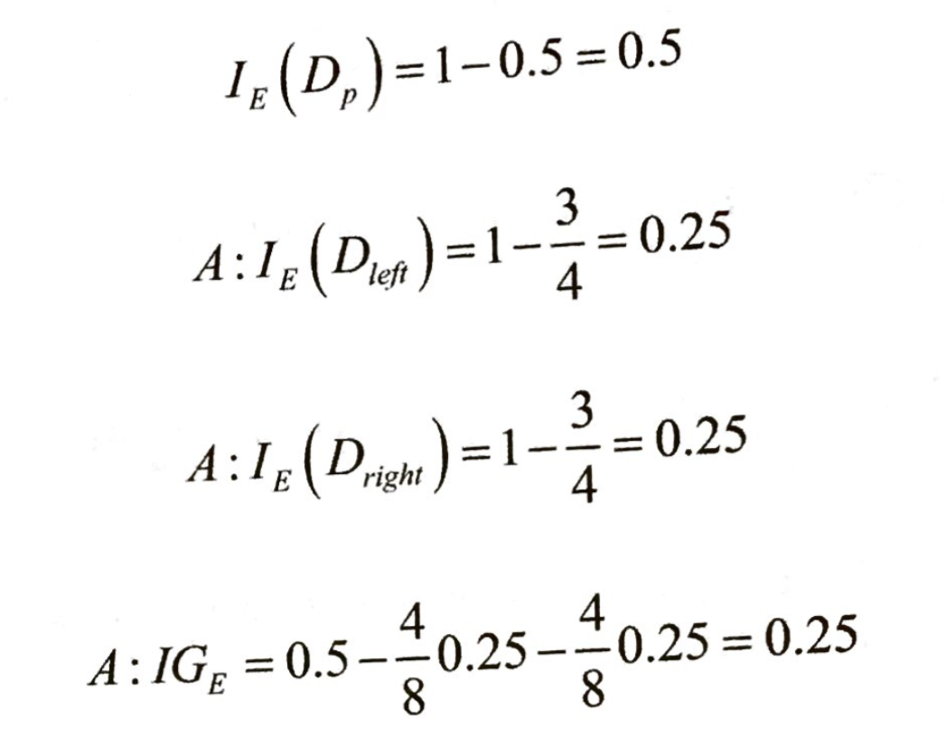
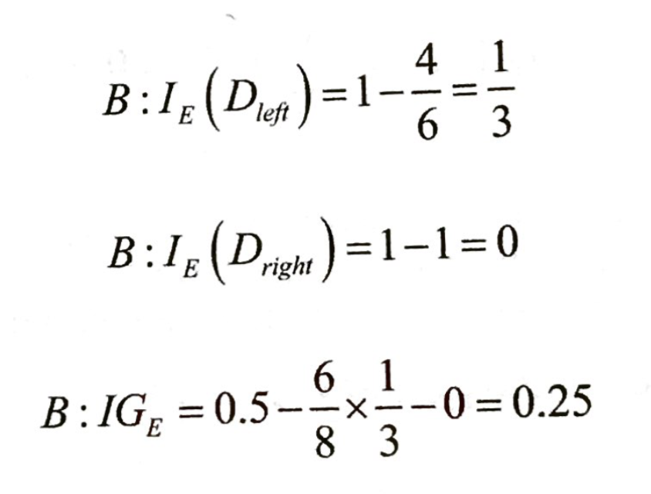
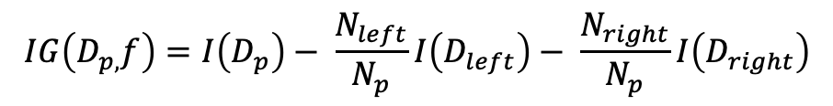

$$I_{E}=1−max⁡\{p(i|t)\}$$
$$IG\left(D_{p,}f\right)=I\left(D_{p}\right)− \frac{N_{left}}{N_{p}}I\left(D_{left}\right)− \frac{N_{right}}{N_{p}}I\left(D_{right}\right)$$
3. The Classification Error
Information gain using the classification error as a splitting criterion would be the same for scenarios A and B.

Slide 19
Key Parameters of Tree Modeling & How can we avoid over-fitting in Decision Tree?
Setting Constraints on Tree Size
Tree Pruning

Slide 20
Setting Constraints on Tree Size
Minimum samples for a node split
Defines the minimum number of samples (or observations) which are required in a node to be considered for splitting.
Used to control over-fitting. Higher values prevent a model from learning relations which might be highly specific to the particular sample selected for a tree.
Too high values can lead to under-fitting hence, it should be tuned using CV.
Minimum samples for a terminal node (leaf)
Defines the minimum samples (or observations) required in a terminal node or leaf.
Used to control over-fitting similar to min_samples_split.
Generally lower values should be chosen for imbalanced class problems because the regions in which the minority class will be in majority will be very small.
Maximum depth of tree (vertical depth)
The maximum depth of a tree.
Used to control over-fitting as higher depth will allow model to learn relations very specific to a particular sample.
Should be tuned using CV.
Maximum number of terminal nodes
The maximum number of terminal nodes or leaves in a tree.
Can be defined in place of max_depth. Since binary trees are created, a depth of ‘n’ would produce a maximum of 2^n leaves.
Maximum features to consider for split
The number of features to consider while searching for a best split. These will be randomly selected.
As a thumb-rule, square root of the total number of features works great but we should check up to 30-40% of the total number of features.
Higher values can lead to over-fitting but depends on case to case.

Slide 21
Tree Pruning
We first make the decision tree to a large depth.
Then we start at the bottom and start removing leaves which are giving us negative returns when compared from the top.
Suppose a split is giving us a gain of say -10 (loss of 10) and then the next split on that gives us a gain of 20. A simple decision tree will stop at step 1 but in pruning, we will see that the overall gain is +10 and keep both leaves.

Slide 22
Are tree based models better than linear models?
If the relationship between dependent & independent variable is well approximated by a linear model, linear regression will outperform tree based model.
If there is a high non-linearity & complex relationship between dependent & independent variables, a tree model will outperform a classical regression method.
If you need to build a model which is easy to explain to people, a decision tree model will always do better than a linear model. Decision tree models are even simpler to interpret than linear regression!

Slide 23
Decision Tree Code Implementation

